Slide 1

How we do CQRS & ES
by Gabriel N. Schenker

Slide 2
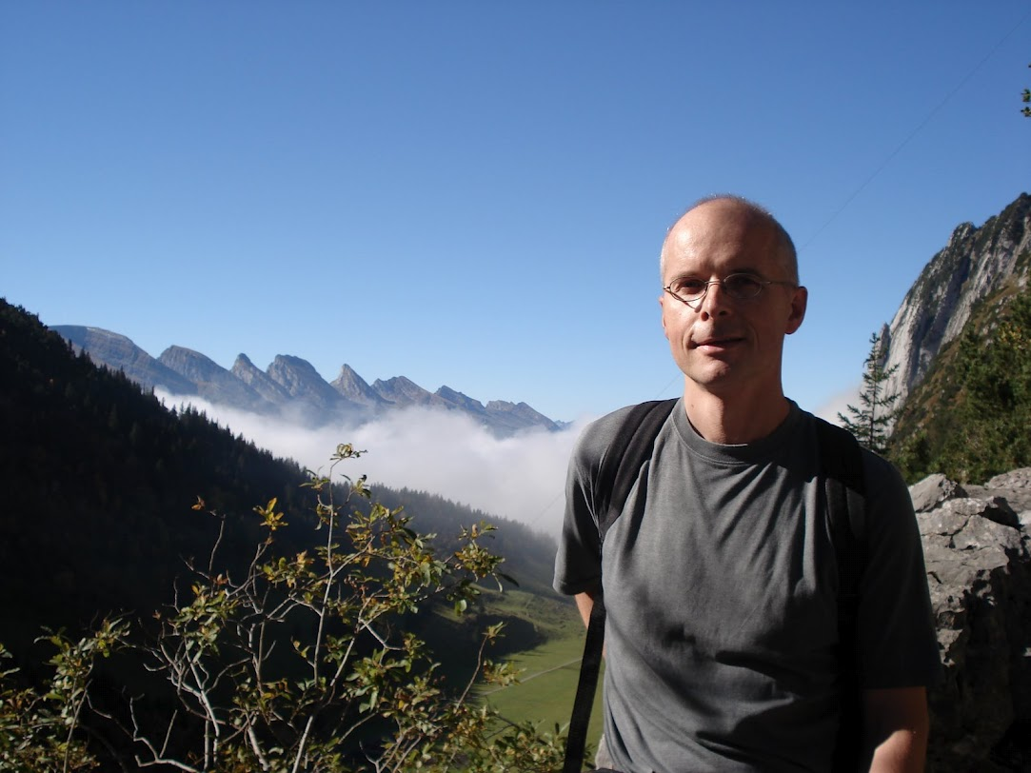
About me
Software Architect
Blogger
Author
Passionate

Slide 3
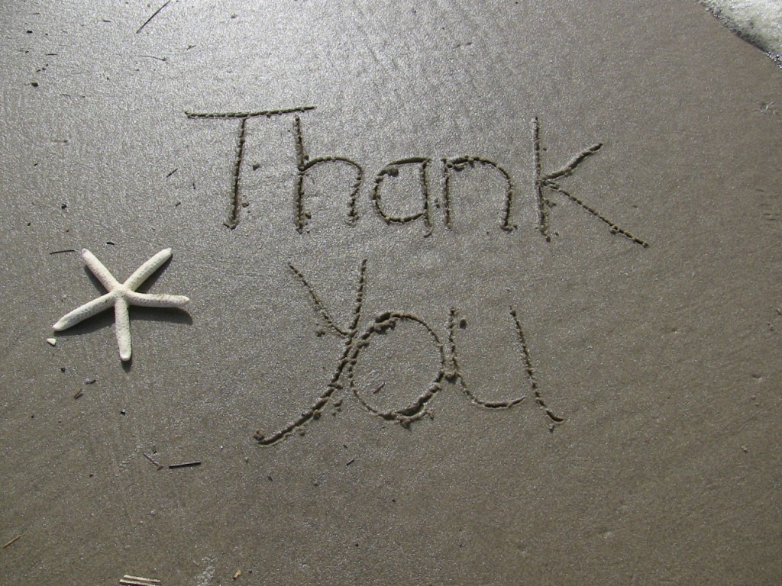
Greg Young
Rinat Abdullin
Jonathan Oliver
Udi Dahan
DDD/CQRS - Group

Slide 4
Magic triangle
Client
ACK/NACK
DTOs
Command
Queries
Domain
Read Model
Events
Events
3
Event Store
Replay
2
1

Slide 5
Domain
Command T
Command Dispatcher
CommandHandler<T>
AggregateFactory
Aggregate
Aggregate
State

Slide 6
Events of a single aggregate instance
n - TaskCompleted
⁞
3 - TaskAccepted
Event Store
2 - TaskPublished
1 - NewTaskScheduled

Slide 7
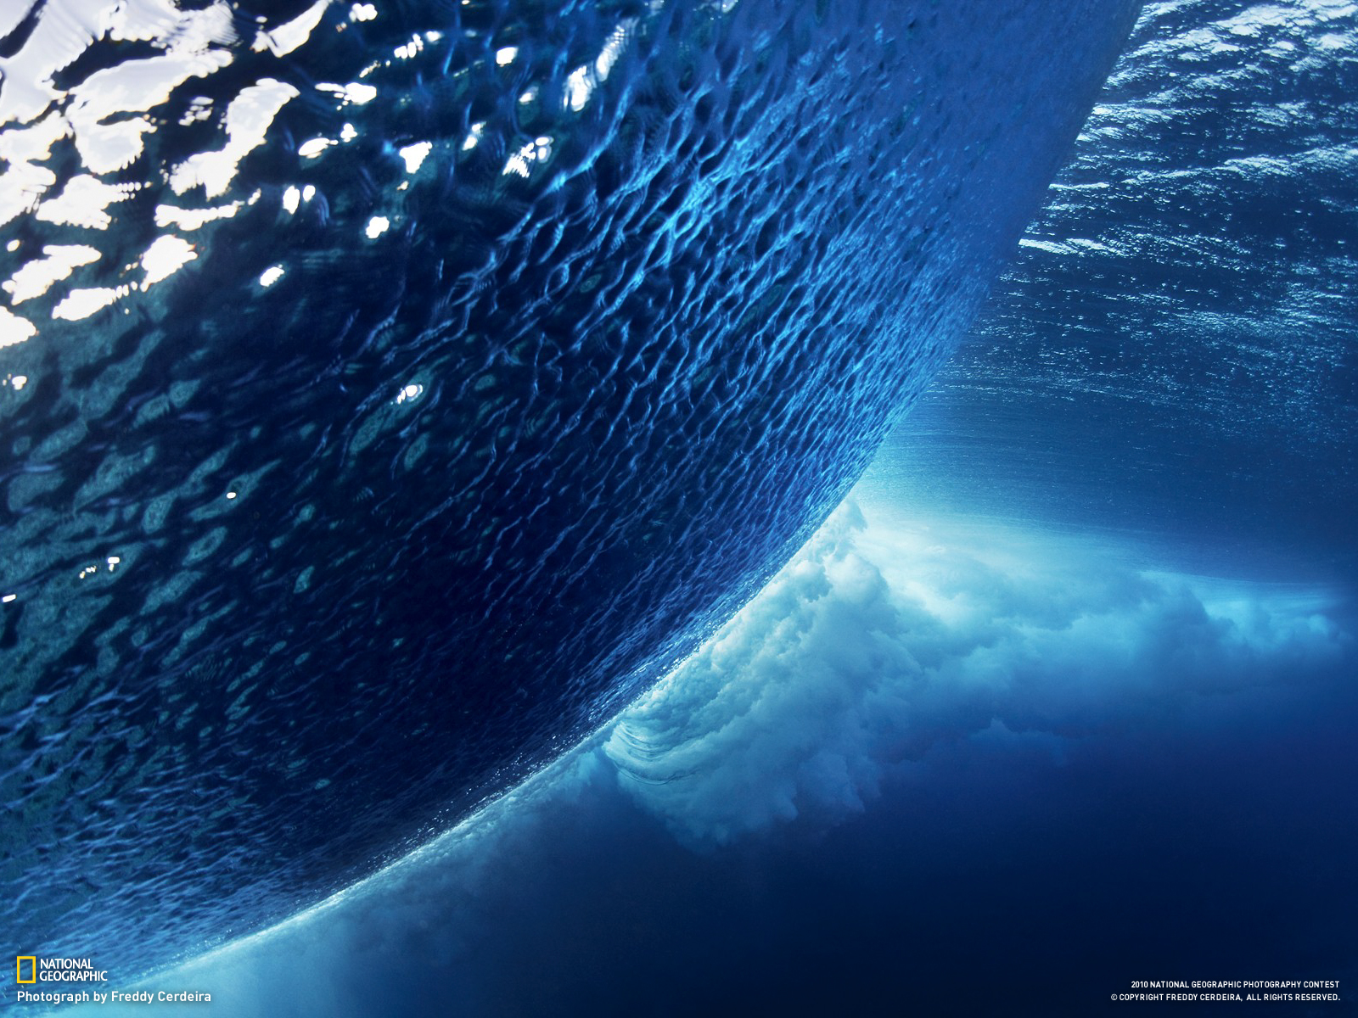
Demo

Slide 8
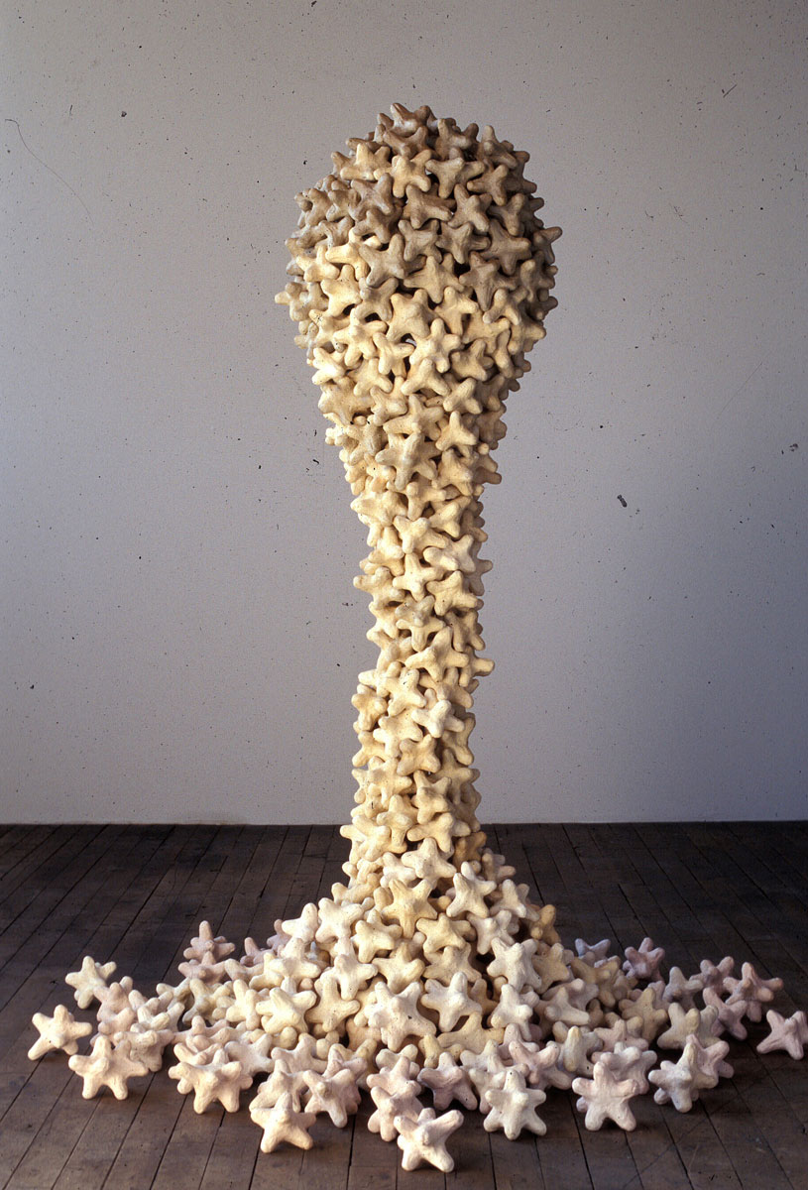
Aggregates
Target of command(s)
Raise events
Are selfish
Behave
Maintain invariants
public void When(PublishTask c)
{
...
}
private void Apply(IEvent<IIdentity> e)
{
observer(e);
...
}
public void When(PublishTask c)
{
if(status != TaskStatus.Draft)
throw new Exception("...");
...
}

Slide 9




Topology
Observer
Router
Event queue
Command queue
Routing queue
Schedule queue

Slide 10

Storage

Slide 11
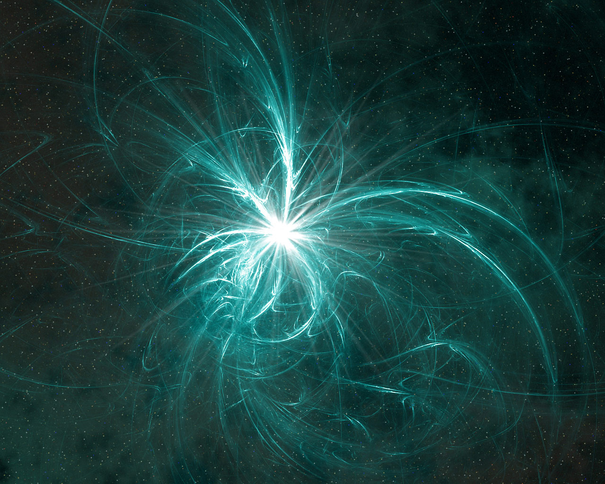
Processes
Coordinate between multiple aggregates
Contain no (significant) business logic
Consume events
Produce commands (and maybe events)
Are not transactional
Run asynchronously
public void When(TaskPublished c)
{
...
}
public void When(TaskPublished c)
{
...
flow.ToEmail(new CreateEmail{...});
}

Slide 12
Event store
Message Header
Contract
Header bytes
Message Contract
Contract name
Content size
Content position
Event₁
Event
Content
Message Header
Contract
Header bytes
Message Contract
Contract name
Content size
Content position
Event₂
Event
Content

